Slide 1
Microbiome Temporal Dynamics and Disease State
Joshua Hamilton
I320D

Slide 2
Problem
01
02
03
Microbiome linked to IBD
Disease activity changes over time
Goal: Predict inflammation early

Slide 3
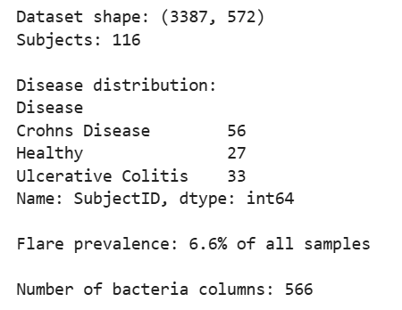
Data
~130 subjects
~2,200 samples
Flare rate: 6.6%
~500 bacterial features (relative abundances)

Slide 4
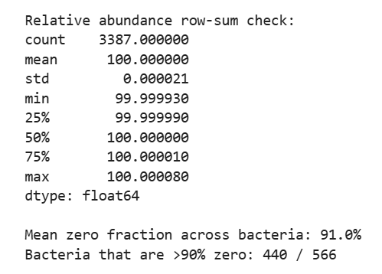
Key Challenges
Compositional Data | All values sum to one
Zero-Inflation: 91% | Most bacteria are absent in most samples
Irregular Sampling | Samples are not evenly spaced in time
Subject Variability | Each person has a very different baseline microbiome

Slide 5
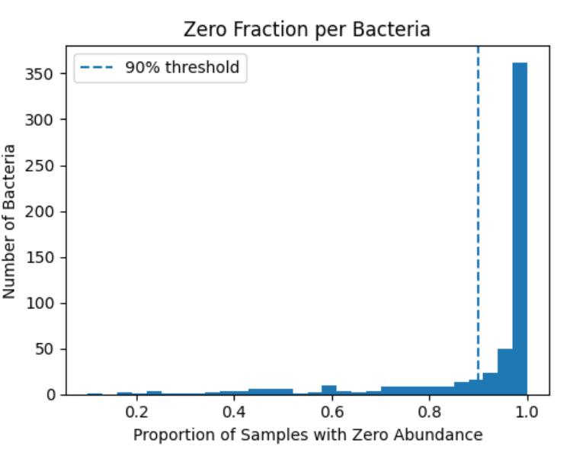
Methods
CLR Transformation
Bray-Curtis Dissimilarity
Temporal Features

Slide 6
Models
LSTM (seq_len = 4)
Logistic Regression (L1)
Features: 1,699

Slide 7
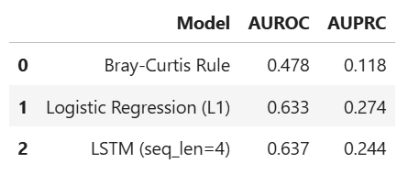
Results
Logistic regression outperforms the baseline and matches or exceeds LSTM performance

Slide 8
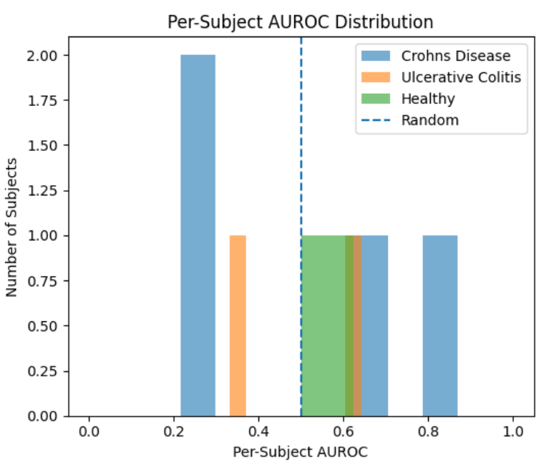
Performance varies substantially across patients

Slide 9
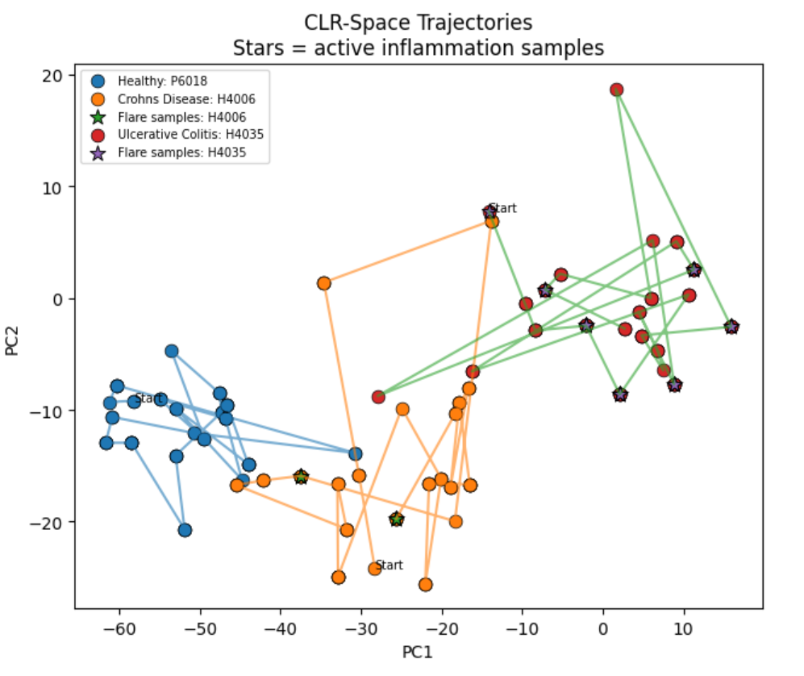
Microbiome Trajectories and Inflammation
Flares correspond to shifts away from baseline microbiome states

Slide 10
Limitations and Takeaways
Correlation does not imply causation
Label timing lag
Sparse and irregular data

Slide 11
Thank you!

